Slide 1
Unit - 3 Input / Output organization
How program-controlled I/O is performed using polling
How interrupts are used in I/O transfers
Direct memory access as an I/O mechanism
Synchronous and asynchronous bus operation
Interface circuits
Commercial standards, such as USB, SCSI, and PCI Express

Slide 2
Text Books:
Carl Hamacher, Zvonko Vranesic, Safwat Zaky: Computer Organization, 5th Edition, Tata McGraw Hill, 2002.
Carl Hamacher, Zvonko Vranesic, Safwat Zaky, Naraig Manjikian : Computer Organization and Embedded Systems, 6th Edition, Tata McGraw Hill, 2012.
Reference Books:
William Stallings: Computer Organization & Architecture, 9th Edition, Pearson, 2015.

Slide 3
Introduction
Computer is its ability to exchange data with other devices.
Communication capability enables a human operator
Applications like an integral part of home appliances, manufacturing equipment, transportation systems, banking and point-of-sale (PoS) terminals.
Input from a sensor switch, a digital camera, a microphone, or a fire alarm.
Output like a sound signal sent to a speaker, or a digitally signal that changes the speed of a motor, opens a valve, or a robot to move in a specified manner.
Computers should have the ability to exchange digital and analog information with a wide range of devices in many different environments.

Slide 4
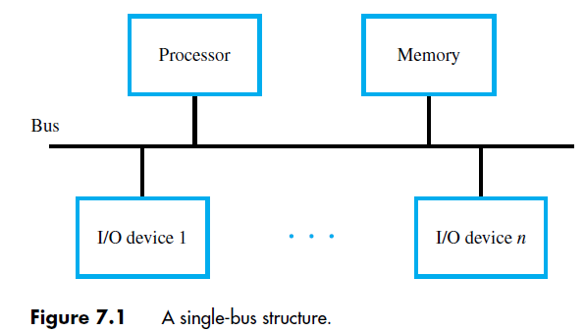
Accessing I/O Devices
I/O device must appear to the processor as consisting of some addressable locations, just like the memory.
The I/O devices and the memory share the same address space, this arrangement is called memory-mapped I/O.

Slide 5
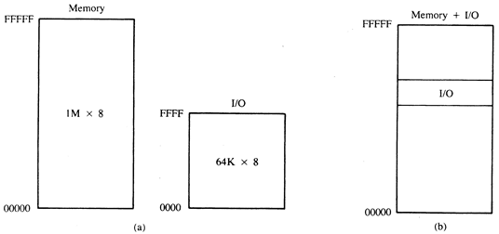
I/O Mapped I/O Memory Mapped I/O

Slide 6
Count..
Memory-mapped I/O, any machine instruction that can access memory can be used to transfer data to or from an I/O device.
For example, if DATAIN is the address of a register in an input device, the instruction
Load R2, DATAIN
reads the data from the DATAIN register and loads them into processor register R2.
Similarly, the instruction
Store R2, DATAOUT
sends the contents of register R2 to location DATAOUT, which is a register in an output device.
In Intel Processor IN and OUT instructions used

Slide 7
Bus
Processor
D
A
T
AIN
D
A
T
A
OUT
SIN
SOUT
K
e
yboard
Display
Figure 2.19
Bus connection for processor
, k
e
yboard, and display
.

Slide 8
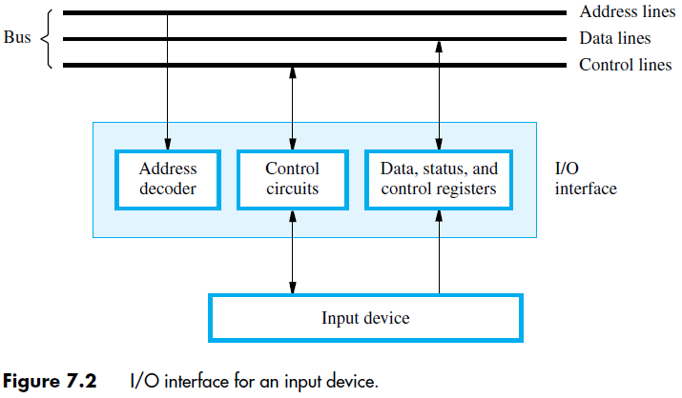
Hardware needed to access I/O devices
Processor places a particular address on the address lines, it is examined by the address decoders of all devices on the bus.
The device that recognizes this address responds to the commands issued on the control lines.
The processor uses the control lines to request either a Read or a Write operation, and the requested data are transferred over the data lines.
Intel processor uses I/O mapped I/O.

Slide 9
Example
Program to reads one line from the keyboard till return key press, store it in memory buffer and echoes it back to the display.

Slide 10
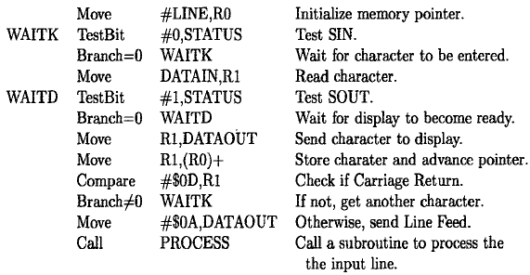
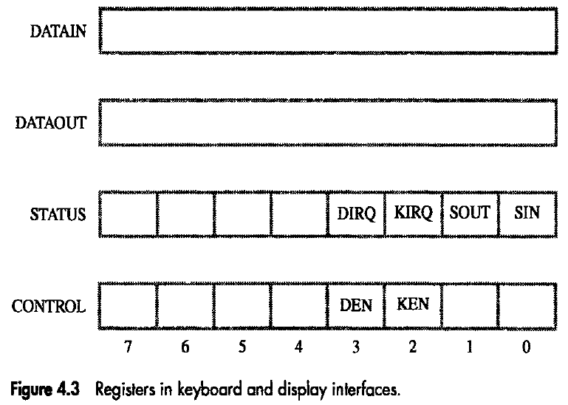
Count..

Slide 11
Program Controlled I/O
Above Example is of Program Controlled I/O
In this processor repeatedly checks a status flags to achieve the required synchronization between the processor and an input or output device
Also called Processor Polls the device
Other methods are Interrupt and DMA

Slide 12
Interrupts -1
Polling method – Processor waits for response from I/O device. During wait period processor not able perform useful computation.
Come out from these problem using Interrupt
Can arrange for the I/O device to alert the processor when it becomes ready. It can do so by sending a hardware signal called an interrupt request to the processor.

Slide 13
Interrupt Example 1
Consider a task that requires continuous extensive computations to be performed and the results to be printed on a printer.

Slide 14
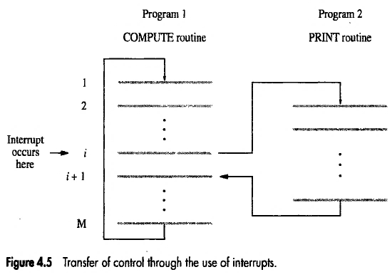
Interrupt Example 2
COMPUTE produces a set of n lines of output.
PRINT routine print this line
After printing one line printer sends Interrupt request signal to the processor. (At i th line.)
So processor interrupt the execution of COMPUTE routine and transfer the control to PRINT routine.

Slide 15
Interrupt -2
The routine executed in response to an interrupt request is called the interrupt-service routine.
E.g. PRINT routine.
ISR/ISP similar to Subroutine
Processor responds or interrupt request responds to interrupted device by sending the control signal called Interrupt Acknowledge.
When interrupt occurs during execution of program processor register used, flag status information must saved in stack before execution of the interrupted program is resumed.
In this way, the original program can continue execution without being affected in any way by the interruption, except for the time delay.
The task of saving and restoring information can be done automatically by the processor or by program instructions.

Slide 16
Interrupt -3
The process of saving and restoring registers involves memory transfers that increase the total execution time, and hence represent execution overhead.
Saving registers also increases the delay between the time an interrupt request is received and the start of execution of the interrupt-service routine.
This delay is called interrupt latency.
The amount of information saved automatically by the processor when an interrupt request is accepted should be kept to a minimum.
This kind of delay not acceptable in Real-time processing.
The ISR returns to interrupted program using Return-from-Interrupt instruction.

Slide 17
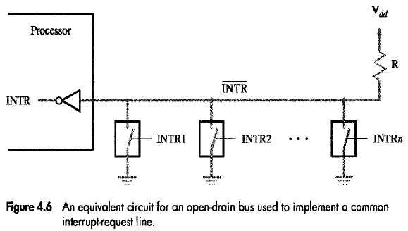
Interrupt Hardware
Interrupt request
If several I/O can request an interrupt.
A single interrupt request line may be used as shown in figure using switch.
When device make interrupt request by closing switch the voltage on the line is ‘0’
INTR is logic OR
INTR= INTR1+INTR2+…..+INTRn
INTR is active low signal

Slide 18
Enabling and Disabling Interrupt-1
Interrupt can occur any time which alter the execution sequence.
To provide programmer complete control over program execution event.
So interruption of program carefully controlled i. e. by Enable and disable interrupt as desire
Some situation interrupt have to ignore e.g. PRINT interrupt the processor even COMPUTE is not ready with text to print.

Slide 19
Enabling and Disabling Interrupt-2
A single interrupt request from one device by activating the interrupt-request signal, it keeps this signal activated until it learns that the processor has accepted its request. This means that the interrupt-request signal will be active during execution of the interrupt-service routine.
It is essential to ensure that this active request signal does not lead to successive interruptions, causing the system to enter an infinite loop from which it cannot recover.
So three possibilities used to handle one or more interrupt request.

Slide 20
Enabling and Disabling Interrupt-3
First Possibility
Ignore the IR until complete the current ISR
i.e. first instruction of ISR is Interrupt Disable and last instruction is Interrupt Enable

Slide 21
Enabling and Disabling Interrupt-4
Second Possibility
Processor first saves the contents of the program counter (PC) and the processor status (PS) register with IE=1 on stack and automatically disable interrupts before starting the execution of the interrupt-service routine.
When return from interrupt instruction is executed the contents of PC and PS is popped with IE=1 from stack.

Slide 22
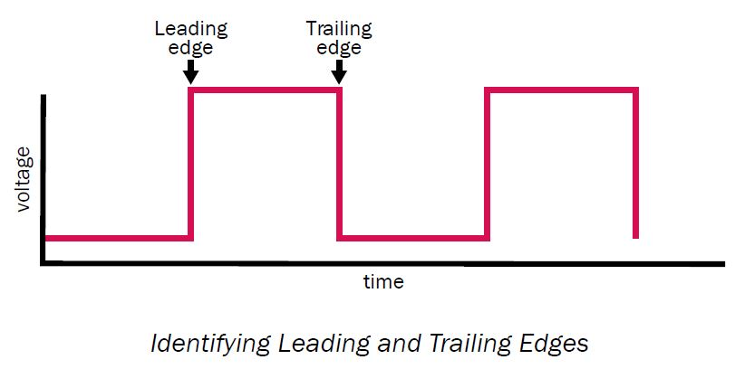
Enabling and Disabling Interrupt-4
Third Possibility
IR line must accept only leading edge of the signal (Edge triggered line)
Processor receive only one request regardless of how long the line is activated.
So no question of multiple interruption or no need of explicit instruction for enable/disable interrupt.

Slide 23
Summarize the sequence of events involved in handling an interrupt request from a single device
The device raises an interrupt request.
The processor interrupts the program currently being executed and saves the contents of the PC and PS registers.
Interrupts are disabled by clearing the IE bit in the PS to 0.
The action requested by the interrupt is performed by the interrupt-service routine, during which time the device is informed that its request has been recognized, and in response, it deactivates the interrupt-request signal.
Upon completion of the interrupt-service routine, the saved contents of the PC and PS registers are restored (enabling interrupts by setting the IE bit to 1), and execution of the interrupted program is resumed.

Slide 24
Handling Multiple Devices-1
The situation where a number of devices capable of initiating interrupts are connected to the processor
E.g. X and Y devices make IR

Slide 25
Handling Multiple Devices-2
Several devices may request interrupts at exactly the same time. This gives rise to a number of questions:
How can the processor determine which device is requesting an interrupt?
Given that different devices are likely to require different interrupt-service routines, how can the processor obtain the starting address of the appropriate routine in each case?
Should a device be allowed to interrupt the processor while another interrupt is being serviced?
How should two or more simultaneous interrupt requests be handled?

Slide 26
Handling Multiple Devices-3
When an interrupt request is received it is necessary to identify the particular device that raised the request.
If two devices raise interrupt requests at the same time.
The information needed to determine whether a device is requesting an interrupt is available in its status register.
IRQ bit e.g. KIRQ and DIRQ
Device request for interrupt the IRQ=1
Processor serve the device using polling method.
But polling need more time
So go for Vectored Interrupt

Slide 27
Handling Multiple Devices-4
Vectored Interrupt
To reduce the time involved in the polling process, a device requesting an interrupt may identify itself directly to the processor. Then, the processor can immediately start executing the corresponding ISR.
A device requesting an interrupt can identify itself if it has its own interrupt-request signal, or if it can send a special code (like memory address of ISR) to the processor through the interconnection network.
A commonly used scheme is to allocate permanently an area in the memory to hold the addresses of interrupt-service routines. These addresses are usually referred to as interrupt vectors, and they are said to constitute the interrupt-vector table.
When an interrupt request arrives, the information provided by the requesting device is used as a pointer into the interrupt-vector table, and the address in the corresponding interrupt vector is automatically loaded into the program counter.

Slide 28
Handling Multiple Devices-5
Interrupt Nesting
If request from more than one device.
Sometimes some device need immediate response from processor e.g. System Clock, Real time system.
This can be resolved by using Priority Based Interrupt.
Multiple-level priority
Interrupt requests will be accepted from some devices but not from others, depending upon the device’s priority. To implement this scheme, we can assign a priority level to the processor that can be changed under program control.
Interrupt requests from higher-priority devices will accepted.
The processor’s priority can be encoded in a few bits of the processor status register.

Slide 29
Handling Multiple Devices-6
Privileged Instruction
Works in supervisor mode i.e. when executing operating system routine.
But in Used mode user program cannot accidently or intentionally change the priority which disrupt the system operation which can be avoided using privilege exception.

Slide 30
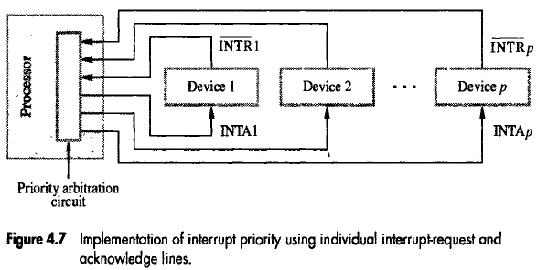
Handling Multiple Devices-7
Multiple priority scheme implemented using individual INTR and INTA lines.
Priority arbitration circuit: A logic circuit which combines all interrupts but allows only the highest-priority request.

Slide 31
Handling Multiple Devices-8
Simultaneous Requests
Polling the status registers of the I/O devices is the simplest such mechanism. In this case, priority is determined by the order in which the devices are polled.
When vectored interrupts are used, we must ensure that only one device is selected to send its interrupt vector code.

Slide 32
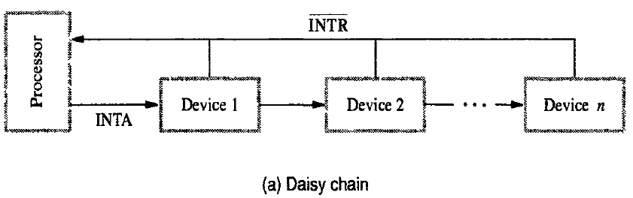
Handling Multiple Devices-9
Daisy Chain
INTR is common to all device
INTA connected in daisy chain fashion where INTA signal propagate serially through the devices.

Slide 33
Handling Multiple Devices-10
When IR is active on INTR line then INTA sent to Device 1 and passes to device 2 if it does not require any service.
In daisy chain, the device that is electrically closest to the processor had the highest priority.

Slide 34
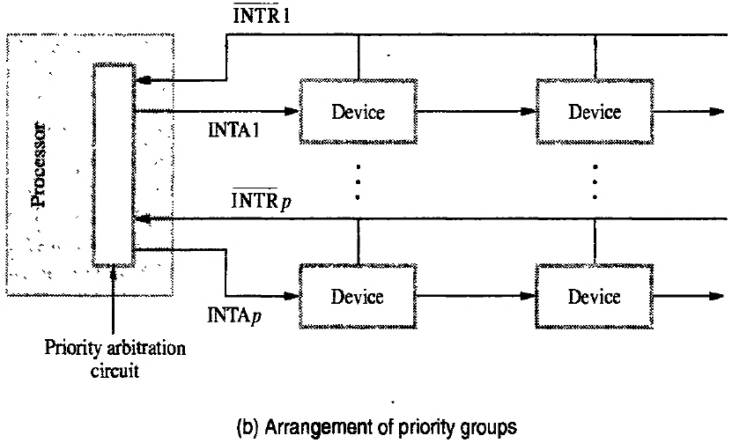
Handling Multiple Devices-11
Combining the Multiple-priority and daisy chain.
Where device organized in group and each have different priority level.

Slide 35
Controlling Device Request-1
It is important to ensure that interrupt requests are generated only by those I/O devices that the processor is currently willing to recognize.
Need a mechanism in the interface circuits of individual devices to control whether a device is allowed to interrupt the processor.
The control needed is usually provided in the form of an interrupt-enable bit in the device’s interface circuit.
To reduce unnecessary interrupt from other I/O devices which are not used by current executing program.

Slide 36
Controlling Device Request-2
Keyboard interrupt enable bit KEN
Display interrupt enable bit DEN
KEN and/or DEN = 1 then only interface circuit generate an IR.
Same time KIRQ and/or DIRQ = 1 indicate that both devices is requesting an interrupt.

Slide 37
Controlling Device Request-3
Example
When a program wish to read an input line from the keyboard and store the character in successive byte location

Slide 38
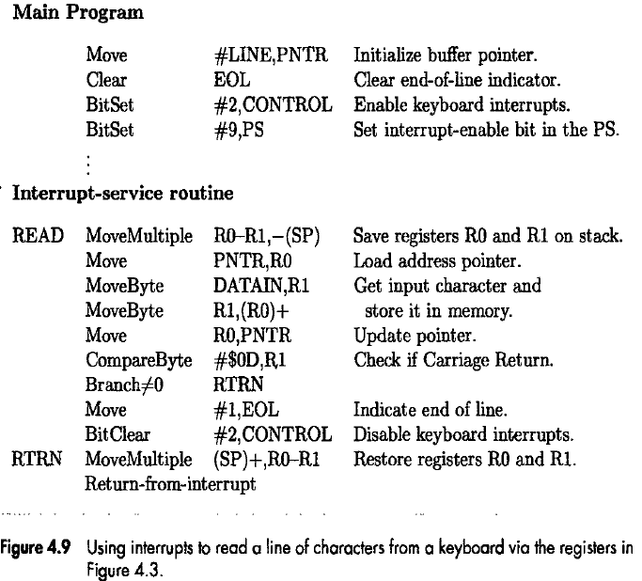
Controlling Device Request-4

Slide 39
Exceptions-1
Any event that causes an interruption.
I/O interrupts are one example of an exception
but other types of exceptions

Slide 40
Exceptions-2
Recovery from Errors
Many computers include an error-checking code in the main memory, which allows detection of errors in the stored data. If an error occurs, the control hardware detects it and informs the processor by raising an interrupt.
The processor proceeds in exactly the same manner as in the case of an I/O interrupt request.
It suspends the program being executed and starts an exception-service routine, which takes appropriate action to recover from the error, if possible or to inform the user about it.

Slide 41
Exceptions-3
Debugging
System software usually includes a program called a debugger, which helps the programmer find errors in a program.
The debugger uses exceptions to provide two important facilities: trace mode and breakpoints.

Slide 42
Exceptions-4 Debugging
Trace Mode
In this mode, an interrupt occurs after the execution of every instruction. An interrupt-service routine in the debugger program is invoked each time this interrupt occurs.
It allows the debugger to assume execution control, enabling the user to enter commands for examining the contents of registers and memory locations.
When the user enters a command to resume execution of the object program, a Return from- interrupt instruction is executed.
The next instruction in the program being debugged is executed, then the debugger is activated again with another interrupt.

Slide 43
Exceptions-5 Debugging
Breakpoints
Breakpoints provide a similar interrupt-based debugging facility, except that the object program being debugged is interrupted only at specific points indicated by the programmer.
For example, the programmer set a breakpoint to determine whether a particular subroutine.
A special instruction called Trap or Software-interrupt is usually used to implement breakpoints.

Slide 44
Exceptions-6
Privilege Exception
To protect the OS from being corrupted by user programs certain instructions (Privilege Instructions) can executed only when processor is in superior mode.
In user mode these instruction not executed, so that user program does not change the priority level of the processor or program access area.

Slide 45
Direct Memory Access (DMA)-1
To transfer large blocks of data at high speed, an alternative approach is used.
A special control unit provided to allow transfer of a block of data directly between an external device and the main memory, without continuous intervention by the processor. This approach is called DMA.

Slide 46
Direct Memory Access (DMA)-2
DMA transfers are performed by a control circuit that is part of the I/O device interface called DMA controller.
For each word transferred, processor provides the memory address and all the bus signals that control data transfer.
Since processor has to transfer blocks of data, the DMA controller must increment the memory address for successive words and keep track of the number of transfers.

Slide 47
Direct Memory Access (DMA)-3
DMA controller can transfer data without intervention by the processor, but its operation under the control of a program executed by the processor.
To initiate the transfer of a block of words, the processor sends the starting address, the number of words in the block, and the direction of the transfer.
On receiving this information, the DMA controller proceeds to perform the requested operation.
When the entire block has been transferred, the controller informs the processor by raising an interrupt signal.
While a DMA transfer is taking place, the program that requested the transfer cannot continue, and the processor can be used to execute another program.
After the DMA transfer is completed, the processor can return to the program that requested the transfer.

Slide 48
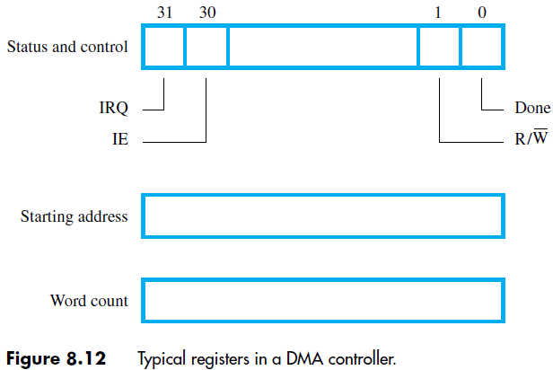
Direct Memory Access (DMA)-4
DMA controller registers that are accessed by the processor to initiate transfer operations.
Two registers are used for storing the Starting address and the word count.
The third register contains status and control flags.
The R/W bit determines the direction of the transfer.
When this bit is set to 1 by a program instruction, the controller performs a read operation, that is, it transfers data from the memory to the I/O device.
When the controller has completed transferring a block of data and is ready to receive another command, it sets the Done flag to 1.
Bit 30 is the Interrupt-enable flag, IE. When this flag is set to 1, it causes the controller to raise an interrupt after it has completed transferring a block of data.
The controller sets the IRQ bit to 1 when it has requested an interrupt.

Slide 49
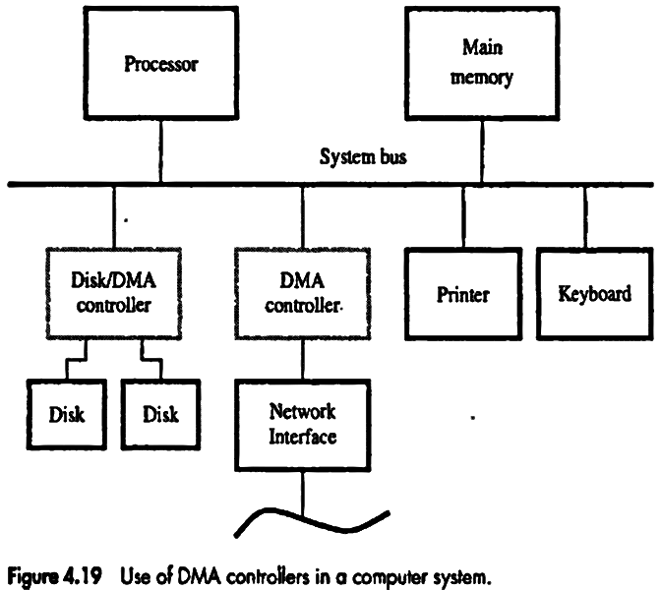
Direct Memory Access (DMA)-5

Slide 50
Direct Memory Access (DMA)-6
The disk controller, which controls two disks, also has DMA capability and provides two DMA channels. It can perform two independent DMA operations, as if each disk had its own DMA controller.
The registers needed to store the memory address, the word count, and so on are duplicated, so that one set can be used with each device.

Slide 51
Direct Memory Access (DMA)-8
Requests by DMA devices for using the bus are always given higher priority than processor requests.
Among different DMA devices, top priority is given to high-speed peripherals such as a disk, a high-speed network interface, or a graphics display device.
Since the processor originates most memory access cycles, the DMA controller can be said to “steal” memory cycles from the processor.
Interweaving technique is usually called cycle stealing.
Alternatively, the DMA controller may be given exclusive access to the main memory to transfer a block of data without interruption. This is known as block or burst mode.
A conflict may arise if both the processor and a DMA controller or two DMA controllers try to use the bus at the same time to access the main memory. To resolve these conflicts, an arbitration procedure is implemented on the bus to coordinate the activities of all devices requesting memory transfers.

Slide 52
Direct Memory Access (DMA)-9
Bus Arbitration
The device that is allowed to initiate data transfers on the bus at any given time is called the bus master.
When the current master relinquishes control of the bus, another device can acquire this status.
Bus arbitration is the process by which the next device to become the bus master is selected and bus mastership is transferred to it.
The selection of the bus master must take into account the needs of various devices by establishing a priority system for gaining access to the bus.
There are two approaches to bus arbitration: centralized and distributed.
In centralized arbitration, a single bus arbiter performs the required arbitration. In distributed arbitration, all devices participate in the selection of the next bus master.

Slide 53
Direct Memory Access (DMA)-10
Bus Arbitration
Centralized Arbitration
The bus arbiter may be the processor or a separate unit connected to the bus. The processor is normally the bus master unless it grants bus mastership to one of the DMA controllers.
A DMA controller indicates that it needs to become the bus master by activating the Bus-Request line BR (Active Low).
When Bus-Request is activated, the processor activates the Bus-Grant signal, BG1, indicating to the DMA controllers that they may use the bus when it becomes free.
This signal is connected to all DMA controllers using a daisy-chain arrangement.
The current bus master indicates to all device that it is using the bus by activating line called Bus-Busy (Active Low)
Bus-Busy to prevent other devices from using the bus at the same time

Slide 54
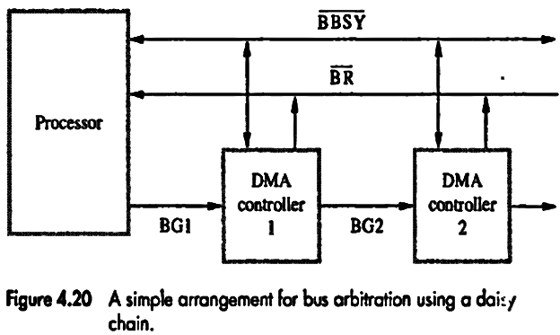
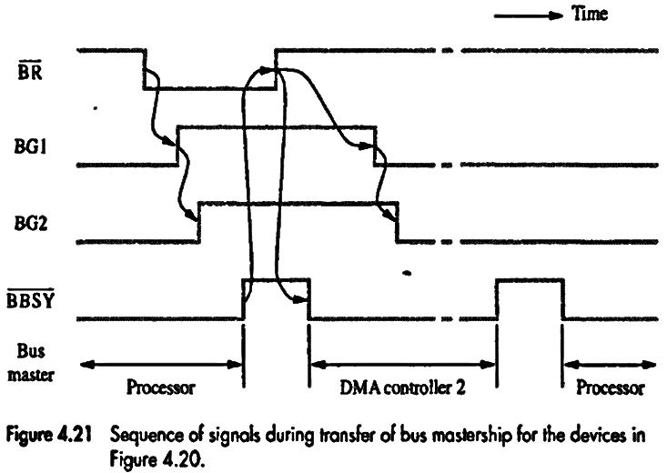
Direct Memory Access (DMA)-11

Slide 55
Direct Memory Access (DMA)-12
Bus Arbitration
Distributed Arbitration
Distributed arbitration means that all devices waiting to use the bus have equal responsibility in carrying out the arbitration process, without using a central arbiter.
Each device on the bus assigned a 4-bit identification number. When one or more devices request the bus, they assert the Start Arbitration (Active Low) signal and place their 4-bit ID numbers on four line, ARB0 through ARB3 .
A winner is selected as a result of the interaction among the signals transmitted over those liens by all contenders.
The net outcome is that the code on the four lines represents the request that has the highest ID number.

Slide 56
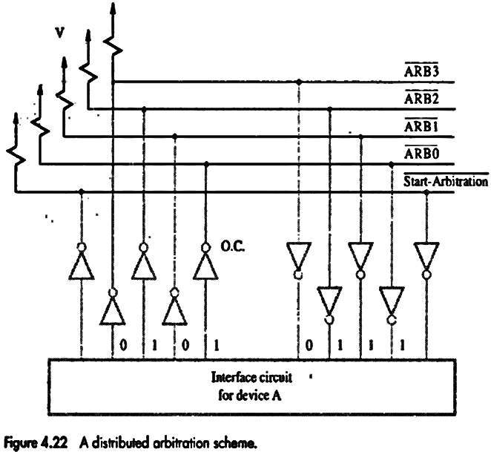
Direct Memory Access (DMA)-13
Device A and B having ID 5 (0101) and 6 (0110).
Both sent the ID
Code seen by both device is 0111.
Each device compares the pattern on the arbitration lines to it own ID, starting from MSB. If it detects a difference at any bit position, it disables its drivers at that bit position and for all lower order bits.

Slide 57
Direct Memory Access (DMA)-13
It does so by placing 0 at the input of these drivers.
Device-A detects a difference on line ARB1 so it disable line ARB1 and ARB0.
So Device-B wins because pattern change to 0110.

Slide 58
Buses-1
The bus protocol determines when a device may place information on the bus, when it may load the data on the bus into one of its registers, and so on.
These rules are implemented by control signals that indicate what and when actions are to be taken.
Master or initiator- Device which initiate data transfers
Slave or target- Device addressed by master

Slide 59
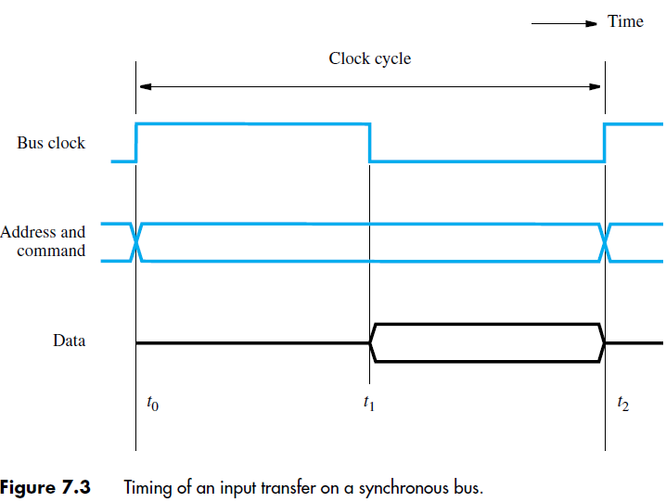
Buses-2 Synchronous Bus
All devices derive timing information from a control line called the bus clock
The timing diagram shows an idealized representation of the actions that take place on the bus lines.

Slide 60
Buses-3 Synchronous Bus
The sequence of signal events during an input (Read) operation.
At time t0, the master places the device address on the address lines and sends a command on the control lines indicating a Read operation.
Information travels over the bus.
The clock pulse width, t1 − t0, must be longer than the maximum propagation delay over the bus. Also, it must be long enough to allow all devices to decode the address and control signals, so that the addressed device (the slave) can respond at time t1 by placing the requested input data on the data lines.
At the end of the clock cycle, at time t2, the master loads the data on the data lines into one of its registers.
To be loaded correctly into a register, data must be available for a period greater than the setup time of the register.
Hence, the period t2 − t1 must be greater than the maximum propagation time on the bus plus the setup time of the master’s register.

Slide 61
Buses-4 Synchronous Bus
The exact times at which signals change state are somewhat different from idealized representation, because of propagation delays on bus wires and in the circuits of the devices.

Slide 62
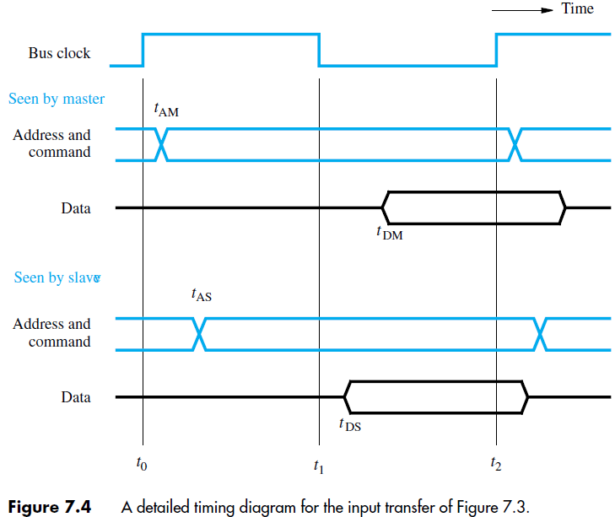
Buses-5 Synchronous Bus

Slide 63
Buses-6 Synchronous Bus
The master sends the address and command signals on the rising edge of the clock at the beginning of the clock cycle (at t0). However, these signals do not actually appear on the bus until t_{AM}, largely due to the delay in the electronic circuit output from the master to the bus lines.
A short while later, at t_{AS}, the signals reach the slave. The slave decodes the address, and at t1 sends the requested data.
Here again, the data signals do not appear on the bus until t_{DS}.
They travel toward the master and arrive at t_{DM}. At t2, the master loads the data into its register.
Hence the period t2 − t_{DM} must be greater than the setup time of that register. The data must continue to be valid after t2 for a period equal to the hold time requirement of the register.

Slide 64
Buses-7 Synchronous Bus Multiple-Cycle Data Transfer
However, it has some limitations.
Because a transfer has to be completed within one clock cycle, the clock period, t2 − t0, must be chosen to accommodate the longest delays on the bus and the slowest device interface.
This forces all devices to operate at the speed of the slowest device.
To overcome these limitations, most buses incorporate control signals that represent a response from the device. These signals inform the master that the slave has recognized its address and that it is ready to participate in a data transfer operation. They also make it possible to adjust the duration of the data transfer period to match the response speeds of different devices.
This is often accomplished by allowing a complete data transfer operation to span several clock cycles. Then, the number of clock cycles involved can vary from one device to another.

Slide 65
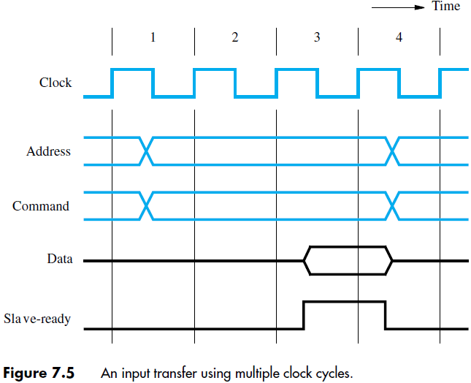
Buses-8 Synchronous Bus Multiple-Cycle Data Transfer

Slide 66
Buses-9 Synchronous Bus Multiple-Cycle Data Transfer
During clock cycle 1, the master sends address and command information on the bus, requesting a Read operation.
The slave receives this information and decodes it. It begins to access the requested data on the active edge of the clock at the beginning of clock cycle 2.
Due to the delay involved in getting the data, the slave cannot respond immediately. The data become ready and are placed on the bus during clock cycle 3.
The slave asserts a control signal called Slave-ready at the same time.
The master, which has been waiting for this signal, loads the data into its register at the end of the clock cycle.
The slave removes its data signals from the bus and returns its Slave-ready signal to the low level at the end of cycle 3.
The bus transfer operation is now complete, and the master may send new address and command signals to start a new transfer in clock cycle 4.
If the addressed device does not respond at all, the master waits for some predefined maximum number of clock cycles, then aborts the operation.

Slide 67
Buses-10 Asynchronous Bus
An alternative scheme for controlling data transfers on a bus is based on the use of a handshake protocol between the master and the slave.
A handshake is an exchange of command and response signals between the master and the slave.

Slide 68
Buses-10 Asynchronous Bus
The master places the address and command information on the bus. Then it indicates to all devices that it has done so by activating the Master-ready line.
This causes all devices to decode the address. The selected slave performs the required operation and informs the processor that it has done so by activating the Slave-ready line.
The master waits for Slave-ready to become asserted before it removes its signals from the bus.
In the case of a Read operation, it also loads the data into one of its registers.

Slide 69
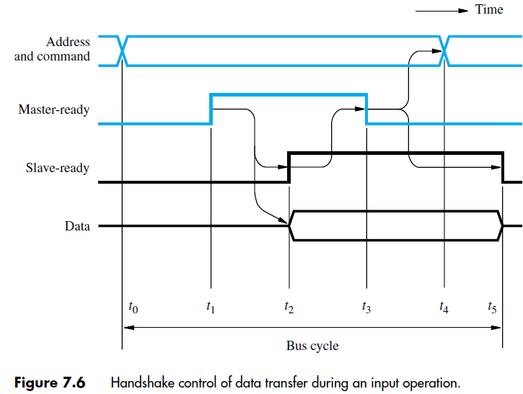
Buses-10 Asynchronous Bus

Slide 70
Buses-10 Asynchronous Bus
t0—The master places the address and command information on the bus, and all devices on the bus decode this information.
t1—The master sets the Master-ready line to 1 to inform the devices that the address and command information is ready. Sufficient time should be allowed for the device interface circuitry to decode the address. The delay needed can be included in the period t1 − t0.
t2—The selected slave, having decoded the address and command information, performs the required input operation by placing its data on the data lines. At the same time, it sets the Slave-ready signal to 1. If extra delays are introduced by the interface circuitry before it places the data on the bus, the slave must delay the Slave-ready signal accordingly. The period t2 − t1 depends on the distance between the master and the slave and on the delays introduced by the slave’s circuitry.

Slide 71
Buses-11 Asynchronous Bus
t3—The Slave-ready signal arrives at the master, indicating that the input data are available on the bus. After a delay to the master loads the data into its register. Then, it drops the Master-ready signal, indicating that it has received the data.
t4—The master removes the address and command information from the bus. The delay between t3 and t4 is again intended to allow for bus skew. Erroneous addressing may take place if the address, as seen by some device on the bus, starts to change while the Master-ready signal is still equal to 1.
t5—When the device interface receives the 1-to-0 transition of the Master-ready signal, it removes the data and the Slave-ready signal from the bus. This completes the input transfer.

Slide 72
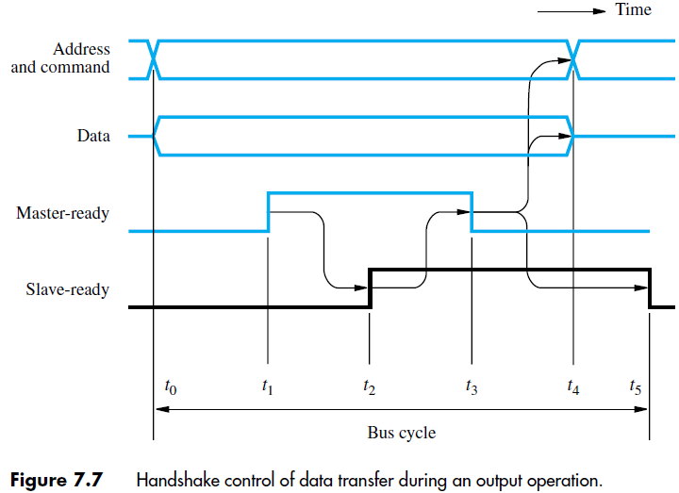
Buses-12 Asynchronous Bus

Slide 73
Interface Circuits

Slide 74
Interface circuits-1
I/O interface consists of the circuitry required to connect an I/O device to a computer bus.
Side of the interface which connects to the computer has bus signals for:
Address,
Data
Control
Side of the interface which connects to the I/O device has:
Datapath and associated controls to transfer data between the interface and the I/O device.
This side is called as a “port”.
Ports can be classified into two:
Parallel port,
Serial port.

Slide 75
Interface circuits-2
Parallel port transfers data in the form of a number of bits, normally 8 or 16 to or from the device.
Serial port transfers and receives data one bit at a time.
Processor communicates with the bus in the same way, whether it is a parallel port or a serial port.
Conversion from the parallel to serial and vice versa takes place inside the interface circuit.

Slide 76
Parallel port
Data
Address
D
A
T
AIN
Data
Encoder
Processor
R
/
W
SIN
and
K
e
yboard
debouncing
switches
Master
-ready
V
alid
circuit
Sla
v
e-ready
Input
interf
ace
Keyboard is connected to a processor using a parallel port.
Processor is 32-bits and uses memory-mapped I/O and the asynchronous bus
protocol.
On the processor side of the interface we have:
- Data lines.
- Address lines
- Control or R/W line.
- Master-ready signal and
- Slave-ready signal.

Slide 77
Parallel port (contd..)
Data
Address
D
A
T
AIN
Data
Encoder
Processor
R
/
W
SIN
and
K
e
yboard
debouncing
switches
Master
-ready
V
alid
circuit
Sla
v
e-ready
Input
interf
ace
On the keyboard side of the interface:
- Encoder circuit which generates a code for the key pressed.
- Debouncing circuit which eliminates the effect of a key bounce (a single key
stroke may appear as multiple events to a processor).
- Data lines contain the code for the key.
- Valid line changes from 0 to 1 when the key is pressed. This causes the code to
be loaded into DATAIN and SIN to be set to 1.

Slide 78
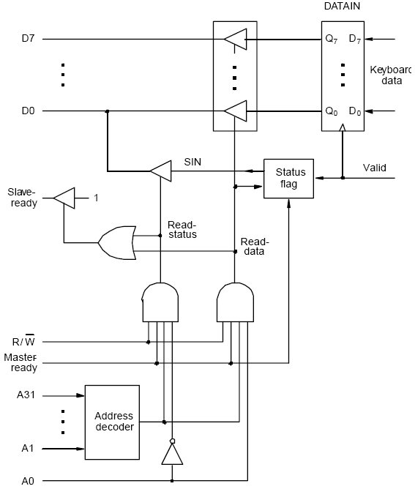
Input Interface Circuit
Output lines of DATAIN are
are connected to the data lines of
the bus by means of 3 state drivers
Drivers are turned on when the
processor issues a read signal and
the address selects this register.
SIN signal is generated using a status flag circuit.
It is connected to line D₀ of the processor bus
using a three-state driver.
Address decoder selects the input interface based
on bits A₁ through A₃₁.
Bit A0 determines whether the status or data
register is to be read, when Master-ready is
active.
In response, the processor activates the Slave-ready
signal, when either the Read-status or Read-data
is equal to 1, which depends on line A₀.

Slide 79
Parallel port (contd..)
Data
Address
D
A
T
A
OUT
Data
Processor
R
/
W
SOUT
CPU
V
alid
Printer
Master
-ready
Output
Idle
Sla
v
e-ready
interf
ace
Printer is connected to a processor using a parallel port.
Processor is 32 bits, uses memory-mapped I/O and asynchronous bus protocol.
On the processor side:
- Data lines.
- Address lines
- Control or R/W line.
- Master-ready signal and
- Slave-ready signal.

Slide 80
Parallel port (contd..)
Data
Address
D
A
T
A
OUT
Data
Processor
R
/
W
SOUT
CPU
V
alid
Printer
Master
-ready
Output
Idle
Sla
v
e-ready
interf
ace
On the printer side:
- Idle signal line which the printer asserts when it is ready to accept a character.
This causes the SOUT flag to be set to 1.
- Processor places a new character into a DATAOUT register.
- Valid signal, asserted by the interface circuit when it places a new character
on the data lines.

Slide 81
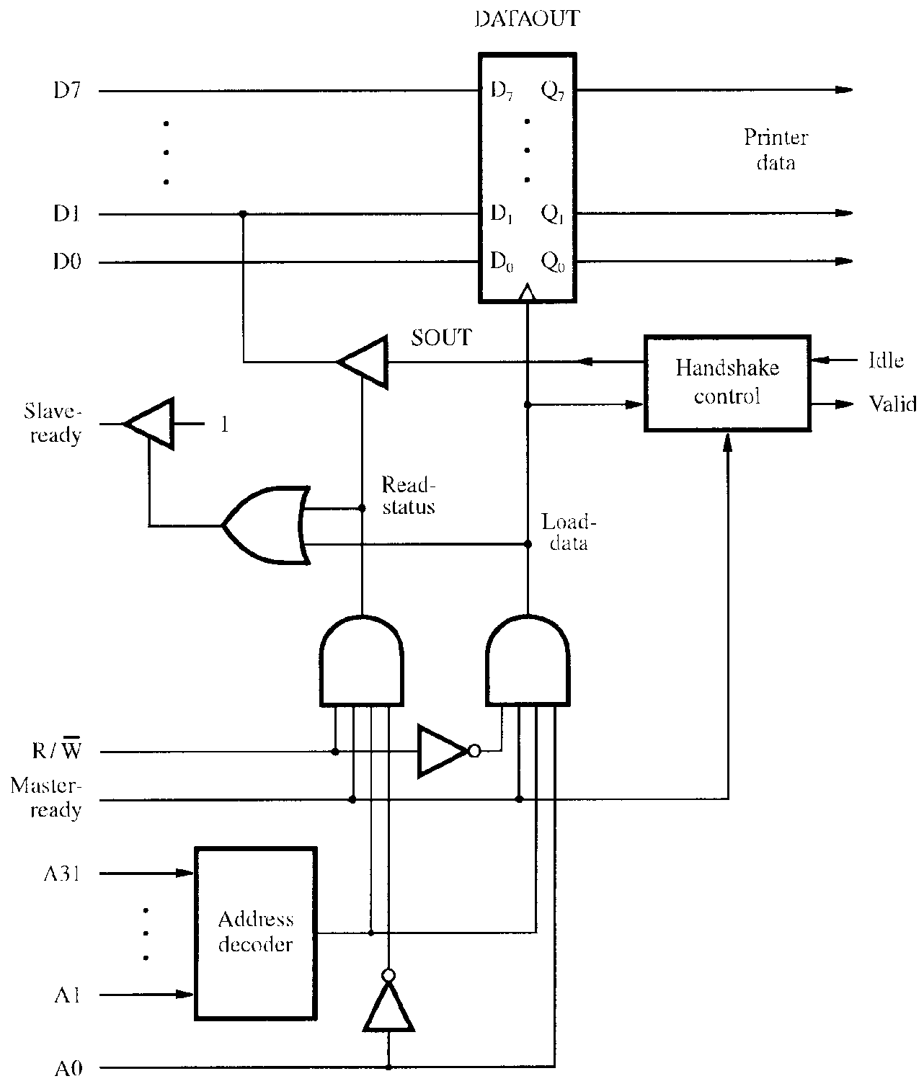
Output Interface Circuit
Data lines of the processor bus are connected to the DATAOUT register of the interface.
The status flag SOUT is connected
to the data line D1 using a three-state driver.
The three-state driver is turned on,
when the control Read-status line is
1.
Address decoder selects the output
interface using address lines A1
through A31.
Address line A0 determines whether
the data is to be loaded into the
DATAOUT register or status flag is
to be read.
If the Load-data line is 1, then the
Valid line is set to 1.
If the Idle line is 1, then the status
flag SOUT is set to 1.

Slide 82
D7
Bus
P
A7
D
A
T
AIN
D1
D0
P
A0
Combined I/O interface circuit.
Address bits A2 through A31, that is
30 bits are used to select the overall
interface.
Address bits A1 through A0, that is, 2
bits select one of the three registers,
namely, DATAIN, DATAOUT, and
the status register.
Status register contains the flags SIN and
SOUT in bits 0 and 1.
Data lines PA0 through PA7 connect the
input device to the DATAIN register.
DATAOUT register connects the data
lines on the processor bus to lines PB0
through PB7 which connect to the output
device.
Separate input and output data lines for
connection to an I/O device.
SIN
Input
CA
status
PB7
D
A
T
A
OUT
PB0
SOUT
Handshak
e
CB1
control
CB2
Sla
v
e-
1
Ready
Master
-
Ready
R
/
W
A31
Address
My-address
decoder
A2
A1
RS1
A0
RS0

Slide 83
D7
P7
Data lines to I/O device are bidirectional.
Data lines P7 through P0 can be used for
both input, and output.
In fact, some lines can be used for input &
some for output depending on the pattern
in the Data Direction Register (DDR).
Processor places an 8-bit pattern into a DDR.
If a given bit position in the DDR is 1, the
corresponding data line acts as an output
line, otherwise it acts as an input line.
C1 and C2 control the interaction between
the interface circuit and the I/O devices.
Ready and Accept lines are the handshake
control lines on the processor bus side, and
are connected to Master-ready & Slave-ready.
Input signal My-address is connected to the
output of an address decoder.
Three register select lines that allow up to 8
registers to be selected.
D
A
T
AIN
D0
P0
D
A
T
A
OUT
Data
Direction
Re
gister
My-address
RS2
C1
RS1
Re
gister
Status
RS0
select
and
R
/
W
control
Ready
C2
Accept
INTR

Slide 84
Serial port
Serial port is used to connect the processor to I/O devices that require transmission of data one bit at a time.
Serial port communicates in a bit-serial fashion on the device side and bit parallel fashion on the bus side.
Transformation between the parallel and serial formats is achieved with shift registers that have parallel access capability.

Slide 85
Input shift re
gister
Serial
input
Input shift register accepts input one bit
at a time from the I/O device.
Once all the 8 bits are received, the
contents of the input shift register are
loaded in parallel into DATAIN register.
Output data in the DATAOUT register
are loaded into the output shift register.
Bits are shifted out of the output shift
register and sent out to the I/O device one
bit at a time.
As soon as data from the input shift reg.
are loaded into DATAIN, it can start
accepting another 8 bits of data.
Input shift register and DATAIN registers
are both used at input so that the input
shift register can start receiving another
set of 8 bits from the input device after
loading the contents to DATAIN, before
the processor reads the contents of
DATAIN. This is called as double-
buffering.
D
A
T
AIN
D7
D0
My-address
D
A
T
A
OUT
RS1
RS0
Chip and
R
/
W
re
gister
Output shift re
gister
Serial
Ready
select
Accept
Recei
ving clock
I
N
T
R
Status
and
ransmission clock
control
T

Slide 86
Serial port (contd..)
Serial interfaces require fewer wires, and hence serial transmission is convenient for connecting devices that are physically distant from the computer.
Speed of transmission of the data over a serial interface is known as the “bit rate”.
Bit rate depends on the nature of the devices connected.
In order to accommodate devices with a range of speeds, a serial interface must be able to use a range of clock speeds.
Several standard serial interfaces have been developed:
Universal Asynchronous Receiver Transmitter (UART) for low-speed serial devices.
RS-232-C for connection to communication links.

Slide 87
Standard I/O interfaces
I/O device is connected to a computer using an interface circuit.
Do we have to design a different interface for every combination of an I/O device and a computer?
A practical approach is to develop standard interfaces and protocols.
A personal computer has:
A motherboard which houses the processor chip, main memory and some I/O interfaces.
A few connectors into which additional interfaces can be plugged.
Processor bus is defined by the signals on the processor chip.
Devices which require high-speed connection to the processor are connected directly to this bus.

Slide 88
Standard I/O interfaces (contd..)
Because of electrical reasons only a few devices can be connected directly to the processor bus.
Motherboard usually provides another bus that can support more devices.
Processor bus and the other bus (called as expansion bus) are interconnected by a circuit called “bridge”.
Devices connected to the expansion bus experience a small delay in data transfers.
Design of a processor bus is closely tied to the architecture of the processor.
No uniform standard can be defined.
Expansion bus however can have uniform standard defined.

Slide 89
Standard I/O interfaces (contd..)
A number of standards have been developed for the expansion bus.
Some have evolved by default.
For example, IBM’s Industry Standard Architecture.
Three widely used bus standards:
PCI (Peripheral Component Interconnect)
SCSI (Small Computer System Interface)
USB (Universal Serial Bus)

Slide 90
Standard I/O interfaces (contd..)
Processor
Main
memory
Bridge circuit translates
signals and protocols from
processor bus to PCI bus.
Processor bus
Bridge
PCI bus
Expansion bus on
the motherboard
Additional
SCSI
Ethernet
USB
ISA
memory
controller
Interface
controller
Interface
SCSI b
us
IDE
V
ideo
disk
Disk
CD-R
OM
controller
controller
Disk 1
Disk 2
CD-
K
e
yboard
Game
R
OM

Slide 91
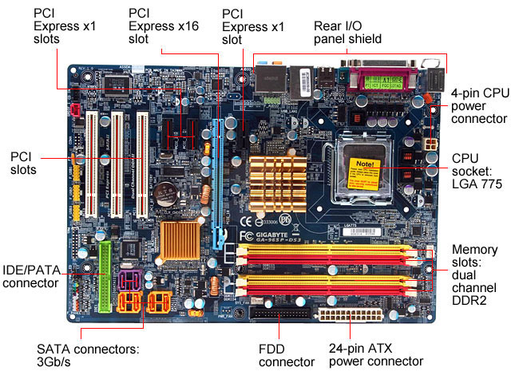

Slide 92
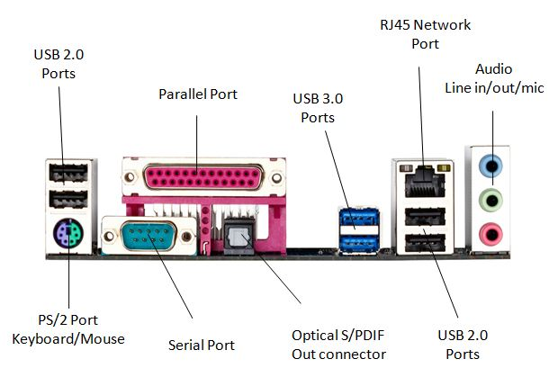
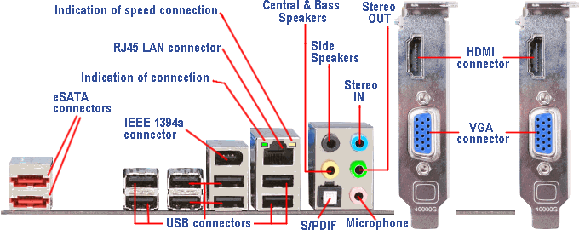

Slide 93
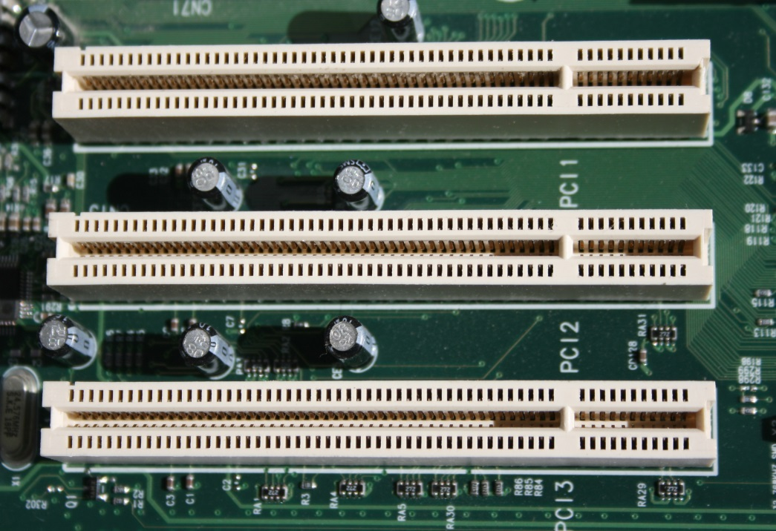
PCI Bus
Peripheral Component Interconnect
Introduced in 1992
Low-cost bus
Processor independent
Plug-and-play capability
In today’s computers, most memory transfers involve a burst of data rather than just one word. The PCI is designed primarily to support this mode of operation.
The bus supports three independent address spaces: memory, I/O, and configuration.
We assumed that the master maintains the address information on the bus until data transfer is completed. But, the address is needed only long enough for the slave to be selected. Thus, the address is needed on the bus for one clock cycle only, freeing the address lines to be used for sending data in subsequent clock cycles. The result is a significant cost reduction.
A master is called an initiator in PCI terminology. The addressed device that responds to read and write commands is called a target.

Slide 94
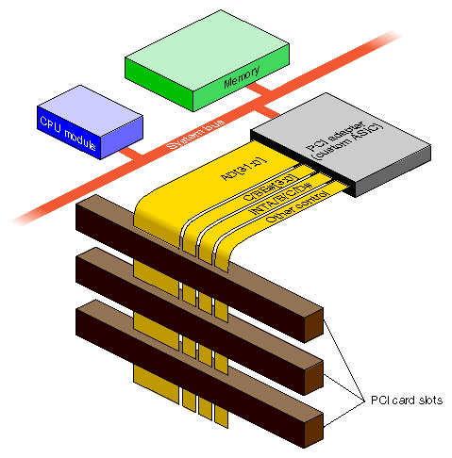
Data transfer signals on the PCI bus.
Name
F
unction
CLK
A
33-MHz
or
66-MHz
clock.
FRAME#
Sent
b
y
the
initiator
to
indicate
the
duration
of
a
transaction.
AD
32
address/data
lines,
which
may
b
e
optionally
increased
to
64.
C/BE#
4
command/byte-enable
lines
(8
for
a
64-bit
bus).
IRD
Y#,
TRD
Y#
Initiator-ready
and
Target-ready
signals.
DEVSEL#
A
response
from
the
device
indicating
that
it
has
recognized
its
address
and
is
ready
for
a
data
transfer
transaction.
IDSEL#
Initialization
Device
Select.
A signal whose name ends with the symbol # is asserted when in the low-voltage state.

Slide 95
1
2
3
4
5
6
7
CLK
Frame#
AD
Adress
#1
#2
#3
#4
C/BE#
Cmnd
Byte enable
IRD
Y#
TRD
Y#
DEVSEL#
A read operation on the PCI bus

Slide 96
1
2
3
4
FRAME# indicate the beginning of a transaction.
Address on the AD lines
Read on the C/BE# lines.
5
6
7
CLK
Frame#
AD
Adress
#1
#2
#3
#4
C/BE#
Cmnd
Byte enable
IRD
Y#
TRD
Y#
DEVSEL#
A read operation on the PCI bus

Slide 97
1
2
3
4
5
6
7
CLK
The initiator removes the address, from the AD lines
The selected target asserts DEVSEL# to indicate recognized its address and is ready to respond
Frame#
AD
Adress
#1
#2
#3
#4
C/BE#
Cmnd
Byte enable
IRD
Y#
TRD
Y#
DEVSEL#
A read operation on the PCI bus

Slide 98
1
2
3
4
5
6
7
CLK
Frame#
AD
Adress
#1
#2
#3
#4
Asserts IRDY# to indicate ready to receive data.
Target asserts TRDY# and begins to send data.
C/BE#
Cmnd
Byte enable
IRD
Y#
TRD
Y#
DEVSEL#
A read operation on the PCI bus

Slide 99
1
2
3
4
5
6
7
If target is not ready , it would delay asserting TRDY# until it is ready.
The entire burst of data need not be sent in successive clock cycles. Either the initiator or the target may introduce a pause by deactivating its ready signal, then asserting it again when it is ready to resume the transfer of data.
CLK
Frame#
AD
Adress
#1
#2
#3
#4
C/BE#
Cmnd
Byte enable
IRD
Y#
TRD
Y#
DEVSEL#
A read operation on the PCI bus

Slide 100
1
2
3
4
5
6
7
CLK
Frame#
FRAME# deactivates this signal during the second-last word of the transfer.
AD
Adress
#1
#2
#3
#4
C/BE#
Cmnd
Byte enable
IRD
Y#
TRD
Y#
DEVSEL#
A read operation on the PCI bus

Slide 101
1
2
3
4
5
6
7
CLK
Frame#
AD
Adress
#1
#2
#3
#4
C/BE#
Cmnd
Byte enable
IRD
Y#
TRD
Y#
DEVSEL#
Target sends one more word then stops.
After sending the fourth word, the target deactivates TRDY# and DEVSEL# and disconnects its drivers on the AD lines.
A read operation on the PCI bus

Slide 102
Device Configuration
When an I/O device is connected to a computer, several actions are needed to configure both the device and the software that communicates with it.
PCI incorporates in each I/O device interface a small configuration ROM memory that stores information about that device.
The configuration ROMs of all devices are accessible in the configuration address space. The PCI initialization software reads these ROMs and determines whether the device is a printer, a keyboard, an Ethernet interface, or a disk controller. It can further learn bout various device options and characteristics.
Devices are assigned addresses during the initialization process.
This means that during the bus configuration operation, devices cannot be accessed based on their address, as they have not yet been assigned one.
Hence, the configuration address space uses a different mechanism. Each device has an input signal called Initialization Device Select, IDSEL#
Electrical characteristics:
PCI bus has been defined for operation with either a 5 or 3.3 V power supply

Slide 103
SCSI Bus
The acronym SCSI stands for Small Computer System Interface.
It refers to a standard bus defined by the American National Standards Institute (ANSI) under the designation X3.131 .
In the original specifications of the standard, devices such as disks are connected to a computer via a 50-wire cable, which can be up to 25 meters in length and can transfer data at rates up to 5 megabytes/s.
The SCSI bus standard has undergone many revisions, and its data transfer capability has increased very rapidly, almost doubling every two years.
SCSI-2 and SCSI-3 have been defined, and each has several options.
Because of various options SCSI connector may have 50, 68 or 80 pins.

Slide 104
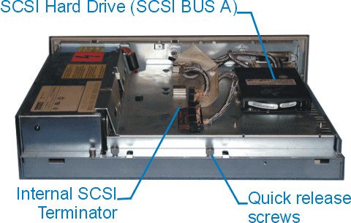
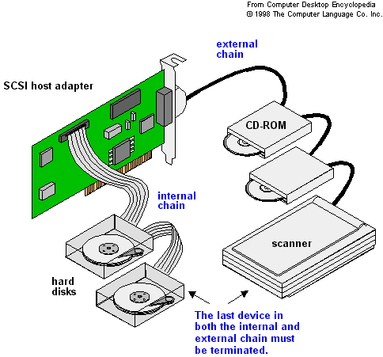

Slide 105
SCSI Bus (Contd.,)
Devices connected to the SCSI bus are not part of the address space of the processor
The SCSI bus is connected to the processor bus through a SCSI controller. This controller uses DMA to transfer data packets from the main memory to the device, or vice versa.
A packet may contain a block of data, commands from the processor to the device, or status information about the device.
A controller connected to a SCSI bus is one of two types – an initiator or a target.
An initiator has the ability to select a particular target and to send commands specifying the operations to be performed. The disk controller operates as a target. It carries out the commands it receives from the initiator.
The initiator establishes a logical connection with the intended target.
Once this connection has been established, it can be suspended and restored as needed to transfer commands and bursts of data.
While a particular connection is suspended, other device can use the bus to transfer information.
This ability to overlap data transfer requests is one of the key features of the SCSI bus that leads to its high performance.

Slide 106
SCSI Bus (Contd.,)
Data transfers on the SCSI bus are always controlled by the target controller.
To send a command to a target, an initiator requests control of the bus and, after winning arbitration, selects the controller it wants to communicate with and hands control of the bus over to it.
Then the controller starts a data transfer operation to receive a command from the initiator.

Slide 107
Standard I/O interfaces (contd..)
Processor
Main
memory
Bridge circuit translates
signals and protocols from
processor bus to SCSI bus.
Processor bus
Bridge
PCI bus
Expansion bus on
the motherboard
Additional
SCSI
Ethernet
USB
ISA
memory
controller
Interface
controller
Interface
SCSI b
us
IDE
V
ideo
disk
Disk
CD-R
OM
controller
controller
Disk 1
Disk 2
CD-
K
e
yboard
Game
R
OM

Slide 108
SCSI Bus (Contd.,)
Assume that processor needs to read block of data from a disk drive and that data are stored in disk sectors that are not contiguous.
The processor sends a command to the SCSI controller, which causes the following sequence of events to take place:
The SCSI controller, acting as an initiator, contends for control of the bus.
When the initiator wins the arbitration process, it selects the target controller and hands over control of the bus to it.
The target starts an output operation (from initiator to target); in response to this, the initiator sends a command specifying the required read operation.
The target, realizing that it first needs to perform a disk seek operation, sends a message to the initiator indicating that it will temporarily suspend the connection between them. Then it releases the bus.
The target controller sends a command to the disk drive to move the read head to the first sector involved in the requested read operation. Then, it reads the data stored in that sector and stores them in a data buffer. When it is ready to begin transferring data to the initiator, the target requests control of the bus. After it wins arbitration, it reselects the initiator controller, thus restoring the suspended connection.

Slide 109
SCSI Bus (Contd.,)
The target transfers the contents of the data buffer to the initiator and then suspends the connection again
The target controller sends a command to the disk drive to perform another seek operation. Then, it transfers the contents of the second disk sector to the initiator as before. At the end of this transfers, the logical connection between the two controllers is terminated.
As the initiator controller receives the data, it stores them into the main memory using the DMA approach.
The SCSI controller sends as interrupt to the processor to inform it that the requested operation has been completed

Slide 110
Bus Signals
Operation of SCSI bus from H/W point of view
Category
Name
F
unction
Data
–
DB(0)
to
Data
lines:
Carry
one
b
yte
of
information
–
DB(7)
during
the
information
transfer
phase
and
iden
tify
device
during
arbitration,
selection
and
reselection
phases
–
DB(P)
P
arit
y
bit
for
the
data
bus
Phase
–
BSY
Busy:
Asserted
when
the
bus
is
not
free
–
SEL
Selection:
Asserted
during
selection
and
reselection
Information
–
C/D
Con
trol/Data:
Asserted
during
transfer
of
type
con
trol
information
(command,
status
or
message)
–
MSG
Message:
indicates
that
the
information being
transferred
is
a
message
Table 4. The SCSI bus signals.

Slide 111
Table 4. The SCSI bus signals.(cont.)
Category
Name
F
unction
Handshake
–
REQ
Request:
Asserted
b
y
a
target
to
request
a
data
transfer
cycle
–
A
CK
Ac
kno
wledge:
Asserted
b
y
the
initiator
when
it
has
completed
a
data
transfer
op
eration
Direction of
–
I/O
Input/Output:
Asserted
to
indicate
an
input
transfer
op
eration
(relativ
e
to
the
initiator)
–
Other
A
TN
A
tten
tion:
Asserted
b
y
an
initiator
when
it
wishes
to
send
a
message
to
a
target
–
RST
Reset:
Causes
all
device
con
trols
to
disconnect
from
the
bus
and
assume
their
start-up
state

Slide 112
Main Phases involved
Arbitration
A controller requests the bus by asserting BSY and by asserting it’s associated data line
When BSY becomes active, all controllers that are requesting bus examine data lines
Selection
Controller that won arbitration selects target by asserting SEL and data line of target. After that initiator releases BSY line.
Target responds by asserting BSY line
Target controller will have control on the bus from then
Information Transfer
Handshaking signals are used between initiator and target
At the end target releases BSY line
Reselection

Slide 113
Targets examine ID
D
B
2
D
B
5
D
B
6
B
S
Y
S
E
L
Free
Arbitration
Selection
Figure 42. Arbitration and selection on the SCSI bus.
Device 6 wins arbitration and selects device 2.

Slide 114
USB
Universal Serial Bus (USB) is an industry standard developed through a collaborative effort of several computer and communication companies, including Compaq, Hewlett-Packard, Intel, Lucent, Microsoft, Nortel Networks, and Philips.
Speed
Low-speed(1.5 Mb/s)
Full-speed(12 Mb/s)
High-speed(480 Mb/s)
Port Limitation
Device Characteristics
Plug-and-play

Slide 115
Universal Serial Bus tree structure
Host computer
Root
hub
Hub
Hub
Hub
de
I/O
I/O
I/O
I/O
vice
de
vice
de
vice
de
vice
de
I/O
I/O
vice
de
vice

Slide 116
Universal Serial Bus tree structure
To accommodate a large number of devices that can be added or removed at any time, the USB has the tree structure as shown in the figure.
Each node of the tree has a device called a hub, which acts as an intermediate control point between the host and the I/O devices. At the root of the tree, a root hub connects the entire tree to the host computer. The leaves of the tree are the I/O devices being served (for example, keyboard, Internet connection, speaker, or digital TV)
In normal operation, a hub copies a message that it receives from its upstream connection to all its downstream ports. As a result, a message sent by the host computer is broadcast to all I/O devices, but only the addressed device will respond to that message. However, a message from an I/O device is sent only upstream towards the root of the tree and is not seen by other devices. Hence, the USB enables the host to communicate with the I/O devices, but it does not enable these devices to communicate with each other.

Slide 117
Addressing
When a USB is connected to a host computer, its root hub is attached to the processor bus, where it appears as a single device. The host software communicates with individual devices attached to the USB by sending packets of information, which the root hub forwards to the appropriate device in the USB tree.
Each device on the USB, whether it is a hub or an I/O device, is assigned a 7-bit address. This address is local to the USB tree and is not related in any way to the addresses used on the processor bus.
A hub may have any number of devices or other hubs connected to it, and addresses are assigned arbitrarily. When a device is first connected to a hub, or when it is powered on, it has the address 0. The hardware of the hub to which this device is connected is capable of detecting that the device has been connected, and it records this fact as part of its own status information. Periodically, the host polls each hub to collect status information and learn about new devices that may have been added or disconnected.
When the host is informed that a new device has been connected, it uses a sequence of commands to send a reset signal on the corresponding hub port, read information from the device about its capabilities, send configuration information to the device, and assign the device a unique USB address. Once this sequence is completed the device begins normal operation and responds only to the new address.

Slide 118
USB Protocols
All information transferred over the USB is organized in packets, where a packet consists of one or more bytes of information. There are many types of packets that perform a variety of control functions.
The information transferred on the USB can be divided into two broad categories: control and data.
Control packets perform such tasks as addressing a device to initiate data transfer, acknowledging that data have been received correctly, or indicating an error.
Data packets carry information that is delivered to a device.
A packet consists of one or more fields containing different kinds of information. The first field of any packet is called the packet identifier, PID, which identifies the type of that packet.
They are transmitted twice. The first time they are sent with their true values, and the second time with each bit complemented
The four PID bits identify one of 16 different packet types. Some control packets, such as ACK (Acknowledge), consist only of the PID byte.

Slide 119
PID
PID
PID
PID
PID
PID
PID
PID
0
1
2
3
0
1
2
3
(a) Packet identifier field
Bits
8
7
4
5
Control packets used for controlling data transfer operations are called token packets.
PID
ADDR
ENDP
CRC16
(b) Token packet, IN or OUT
Bits
8
0 to 8192
16
PID
D
A
T
A
CRC16
(c) Data packet
Figure 45. USB packet format.

Slide 120
Host
Hub
I/O De
vice
T
ok
en
Data0
A
CK
Time
T
ok
en
Data0
A
CK
T
ok
en
Figure: An output
transfer
Data1
A
CK
T
ok
en
Data1
A
CK

Slide 121
Isochronous Traffic on USB
One of the key objectives of the USB is to support the transfer of isochronous data.
Devices that generates or receives isochronous data require a time reference to control the sampling process.
To provide this reference. Transmission over the USB is divided into frames of equal length.
A frame is 1ms long for low-and full-speed data.
The root hub generates a Start of Frame control packet (SOF) precisely once every 1 ms to mark the beginning of a new frame.
The arrival of an SOF packet at any device constitutes a regular clock signal that the device can use for its own purposes.
To assist devices that may need longer periods of time, the SOF packet carries an 11-bit frame number.
Following each SOF packet, the host carries out input and output transfers for isochronous devices.
This means that each device will have an opportunity for an input or output transfer once every 1 ms.

Slide 122
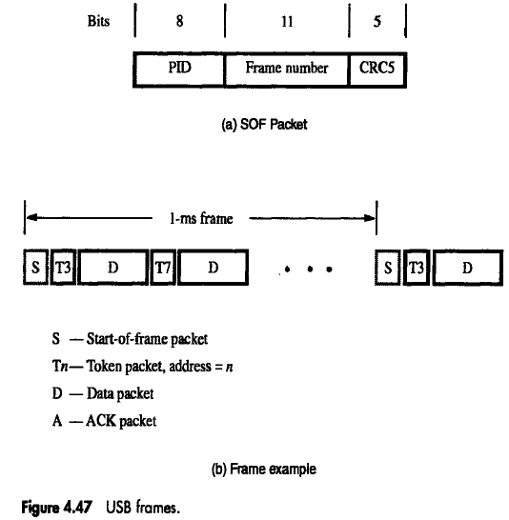
USB Frames

Slide 123
Electrical Characteristics
The cables used for USB connections consist of four wires.
Two are used to carry power, +5V and Ground.
Thus, a hub or an I/O device may be powered directly from the bus, or it may have its own external power connection.
The other two wires are used to carry data.
Different signaling schemes are used for different speeds of transmission.
At low speed, 1s and 0s are transmitted by sending a high voltage state (5V) on one or the other o the two signal wires. For high-speed links, differential transmission is used.

